Slide 1



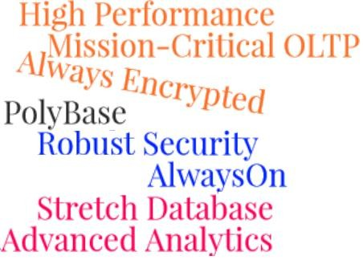
Session 21
SQL Server 2016
Improved Performance Tools and
Transact-SQL Enhancements

Slide 2
Objectives
SQL Server
2016
Explain how to start and use Database Engine Tuning Advisor in SQL Server 2016.
Explain the set of tools for monitoring events in SQL Server 2016 and for tuning the physical database design.
Outline the enhancements in Transact-SQL

Slide 3

In-memory OLTP Enhancements 1-2
SQL Server 2016
Memory-optimized tables are tables stored in the main memory
Memory-optimized tables improve
performance, especially for OLTP
SQL Server 2014 included In-memory OLTP feature, called Hekaton
Hekaton had a separate database engine that integrated into SQL Server and was optimized for memory resident data and OLTP workloads

Slide 4
In-memory OLTP Enhancements 2-2
SQL Server
2016
SQL Server 2014 limitations and enhancements in 2016 are:
SQL Server 2014 Limitation | SQL Server 2016 Enhancement
Total size of memory-optimized tables could not exceed 256 GB of memory | Memory-optimized tables can be up to 2 TB
Could not handle multi-socket servers | Supports four-socket machines
To scan for changes in memory-optimized tables, single offline checkpoint thread was used, causing issues with large number of transactions | Uses multiple threads to track changes and thus boosts performance
The query optimizer did not support parallel queries on memory-optimized tables | Query optimizer supports parallel queries with operations using hash index
Could not handle garbage collection with large volume of data | Has an improved garbage collection algorithms to handle removal of unnecessary data
Used filestream technology to indirectly allocate and manage files | The in-memory OLTP engine directly controls the files and handles operations such as creation and dropping of files
Needed configuration of Management Data Warehouse (MDW) to generate In-memory OLTP reports | Reports can be generated through the SQL Server Management Studio (SSMS)
Did not support Transparent Data encryption(TDA) and Multiple Active Result Sets (MARS) | Supports TDA and MARS

Slide 5

Non-BIN2 Collation Support
SQL Server
2016
SQL Server 2016 does not require BIN2 collation on index key columns in memory-
optimized tables.
Memory-optimized table creation:
cannot be done in system databases
Require the database to have a MEMORY_OPTIMIZED_FILEGROUP that is online and has at least one container.
Sample code creating a memory-optimized database and table
The clause MEMORY_OPTIMIZED=ON makes the NewOrdrs a memory-optimized table. OdrSummary does not use _BIN2 with the COLLATE clause, which indicates that it is non-BIN2 index key.
CREATE DATABASE MUSIC_INVENTORY GO
ALTER DATABASE MUSIC_INVENTORY ADD FILEGROUP MUSIC_INVENTORY_mod CONTAINS MEMORY_OPTIMIZED_DATA ALTER DATABASE MUSIC_INVENTORY ADD FILE (name='MUSIC_INVENTORY_mod1',
filename='d:\MUSIC_INVENTORY_mod1') TO FILEGROUP MUSIC_INVENTORY_mod
ALTER DATABASE MUSIC_INVENTORY SET MEMORY_OPTIMIZED_ELEVATE_TO_SNAPSHOT=ON
GO
USE MUSIC_INVENTORY
CREATE TABLE NewOrdrs (
[Uid] int identity(1,1) NOT NULL, [custname] nvarchar(10) NOT NULL,
[OdrSummary] varchar(50) COLLATE FRENCH_CI_AS NOT NULL -- Non Bin2 -- Collation PRIMARY KEY NONCLUSTERED HASH (Uid) WITH (BUCKET_COUNT=2048))
WITH (MEMORY_OPTIMIZED=ON, DURABILITY = SCHEMA_AND_DATA)

Slide 6


Performance and Monitoring Tools 1-5
SQL Server
2016
Tool | Description
SQL Server Profiler | Monitors server activity for events such as deadlocks, logins, and fatal errors Stores data on monitored events in a table Replays all the events from a single computer
SQL Server Distributed Replay | Performs impact analysis of SQL Server upgrades Replays events on an upgraded test environment Replays captured events from multiple computers Proves effective in simulation of mission-critical environments

Slide 7

Performance and Monitoring Tools 2-5
SQL Server
2016
Tool | Description
Monitor Resource Usage (System Monitor) | Monitors resource usage by server processes Captures server performance using system-defined counter Captures event information using user-defined counters Sets thresholds on counters Triggers alerts as required Monitors SQL Server and Windows operating system simultaneously to understand any interrelated issues
Open Activity Monitor (SQL Server Management Studio) | Available in SQL Server Management Studio Monitors processes on the SQL Server Reports information about user activity, any blocked processes and locks

Slide 8
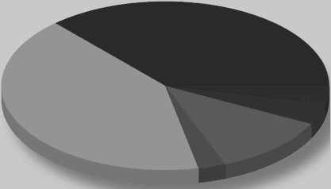
Performance and Monitoring Tools 3-5
SQL Server
2016
Tool | Description
Live Query Statistics | Troubleshoots performance issues of queries Generates statistical information about on-going queries Allows viewing of real-time query statistics on SSML
SQL Trace | Are T-SQL procedures that create traces on a SQL Server Database engine. Can run from the applications directly without the need to use the SQL Server Profiler. The procedures are: sp_trace_create sp_trace_generateevent sp_trace_setevent sp_trace_setfilter sp_trace_setstatus

Slide 9

Performance and Monitoring Tools 4-5
SQL Server
2016
Tool | Description
Error Logs | Help debug server problems. Log information about Windows Server and OS events and also about events occurring in SQL Server and full-text searches.
System Stored Procedures (Transact- SQL) | Monitor and provide information: sp_who: Stores users and processes information. Information about the on-going statement and report if it is blocked sp_lock: Store information on locks such as object ID, index ID, type of lock, and type or resource on which the lock is applied sp_spaceused: Logs information about the amount of disk space used by tables or by database sp_monitor: Logs information about CPU usage, I/O usage and idle- time between executions of two sp_monitor statements

Slide 10

Performance and Monitoring Tools 5-5
SQL Server
2016
Tool | Description
Database Console Command (DBCC) | T_SQL statements that enable viewing of statistical information of performance and the logical and physical consistency of a database
Built-in Functions (Transact-SQL) | SQL Server has in-built counters that record information since the server was started. Some of them are: @@CPU_BUSY stores the amount of time the CPU has been executing SQL Server code @@CONNECTIONS stores the number of SQL Server connections or attempted connections @@PACKET_ERRORS stores the number of network packets occurring on SQL Server connections
Database Engine Tuning Advisor | Scrutinizes the T_SQL statements running on databases Evaluates the performance and accordingly tunes the database Recommends solutions such as to add, remove or modify indexes so that performance can be improved

Slide 11

Tools and Applications
SQL Server
2016
Event or Activity | Applicable Tools
Trend Analysis | SQL Server Profiler, System Monitor
Replaying captured events | SQL Server Profiler (from single computer), Distributed Replay (from multiple computers)
Ad hoc monitoring | SQL Server Profiler, Activity monitor, Transact–SQL, Error Logs
Generating alerts | System monitor
Graphical interface | SQL Server Profiler, System Monitor, Activity Monitor, Error Logs
Usage from applications | SQL Server Profiler system-stored procedures

Slide 12


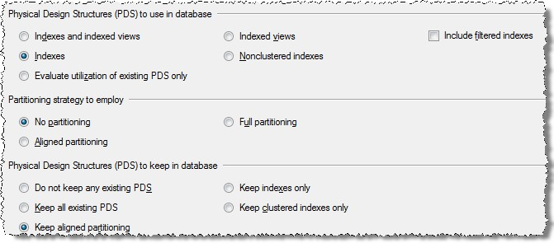
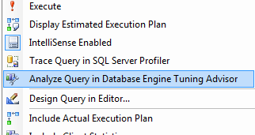

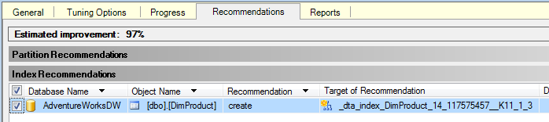
Database Engine Tuning Advisor
SQL Server
2016
Helps tune the physical design structures of a database system which include indexes, clustered indexes, indexed views, and partitions.

Slide 13
SQL Server
2016
Third-Party Tools for Performance Tuning 1-2
Third-Party Tool | Features
DB Performance Center XE by Embarcadero | Provides round-the-clock monitoring of databases to provide information about memory, I/O contention, space, network, objects and users Capable of monitoring mixed database environment Automatically captures SQL Sessions and provisions Generates real-time performance metrics, brief as well as detailed reports Facilitates creation of customized reports and their export to any desired formats
SQL Suite by SQL Solutions | Provides tools Trace Analyzer, Deadlock Detector, Ultimate Debugger, and Heartbeat that help with troubleshooting Trace Analyzer locates code that is causing performance issues and provides resolutions. With the analyzer it can trace time-consuming procedures and procedures using high resources
© Aptech Ltd.
Enhancements in SQL Server
© Aptech Ltd.
SQL Server Inside Out/ Session 21
2016
13

Slide 14
SQL Server
2016
Third-Party Tools for Performance Tuning 2-2
Third-Party Tool | Features
SQL Server Monitor by NetIQ | Monitors and analyzes performance at statement level Triggers alerts to customized threshold levels and automatically provides resolutions Stores real-time monitoring and performance data Provides high-level fault management
Heroix Longitude by Heroix | Measures metrics such as disk I/O, lock wait times, available memory, processor threads, page rates, number of user connections and latency in transactions Is an agent less metrics monitoring solution and supports SQL Server 7, 2000, 2005, and 2008
Zero Impact SQL Monitor by SQL Power Tools | Captures all end-user SQL without any middleware, proxies, or connections to database Provides trend analysis and real-time monitoring of response times and real–time user analysis
© Aptech Ltd.
SQL Server Inside Out/ Session 21
14

Slide 15
T-SQL Enhancements 1-4
SQL Server
2016
Using ALTER INDEX clause it is possible to alter memory-optimized tables.
ALTER TABLE statement can use WITH (ONLINE = ON | OFF) clause and alter many columns while the table remains online.
Foreign keys, check constraints, unique constraints, outer joins, and operators, such as
UNION[ALL], DISTINCT, IN, and EXISTS are supported.
DML triggers and LOB data types are supported on memory-optimized tables.
Nullable columns can be indexed.
Non-BIN2 collations can be used on memory-optimized tables.
The sp_recompile system stored procedure can be run with natively compiled procedures.
In natively compiled procedures, subqueries and nested native procedure calls are supported.
Natively compiled scalar User Defined Functions (UDFs) can be used in the same way as
built-in scalar functions and can also be altered or dropped after their creation.
© Aptech Ltd.
© Aptech Ltd.
Enhancements in SQL Server
2016
SQL Server Inside Out/ Session 21
15

Slide 16

T-SQL Enhancements 2-4
SQL Server
2016
TRUNCATE_TABLE WITH PARTITION
Truncates specific partitions on large partitioned tables can be truncated which simplifies and speeds up maintenance on such tables.
TRUNCATE TABLE [database].[schema].[table] WITH (PARTITIONS [partition
number expression] | [range] );
Where the Partitions argument can be:
o o
number of a partition { Example: (PARTITIONS (8)) }
comma separated list of partitions numbers: {Example: (PARTITIONS
(1,2,3,4))}
o
o
a range with the keyword TO {Example: (PARTITIONS (1 TO 4))}
a combination of the two above {Example: (PARTITIONS (1,2 TO 4))}
For example:
TRUNCATE TABLE dbo.SampleTbl WITH (PARTITIONS (1, 4 TO 8));
© Aptech Ltd.
© Aptech Ltd.
Enhancements in SQL Server
2016
SQL Server Inside Out/ Session 21
16

Slide 17

T-SQL Enhancements 3-4
SQL Server
2016
DROP TABLE IF EXISTS
Provisions to check for the existence of a table before dropping.
DROP TABLE IF EXISTS [dbo].[SampleTbl];
Where SampleTbl is the table to be dropped
The DROP IF statement can also be used with columns, views, indexes, databases, users and so on.
© Aptech Ltd.
© Aptech Ltd.
Enhancements in SQL Server
2016
SQL Server Inside Out/ Session 21
17

Slide 18


T-SQL Enhancements 4-4
SQL Server
2016
Scripts in R language which is used for data science and advanced analytics are supported with the stored procedure sp_execute_external_script.
Temporal tables can be queried to retrieve historical row data.
FOR JSON clause can be used to convert tabular data. Dynamic Data Masking is supported.
Addition of spool operators to query plan can be prevented using NO_PERFORMANCE_SPOOL query hint.
The MAXDOP option can be added to DBCC CHECKTABLE, DBCC CHECKDB and DBCC CHECKFILEGROUP to control the degree of parallelism.
sp_set_session_context, the SESSION_CONTEXT function and the CURRENT_TRANSACTION_ID function can be used to manage session context.
SQL Server Inside Out/ Session 21
18

Slide 19
Summary
SQL Server
2016
SQL Server 2016 Improvements:
In-memory OLTP in SQL Server 2016 is enhanced to overcome all the limitations of SQL Server 2014.
increased memory for memory-optimized tables
improved garbage collection algorithms
better scalability and performance.
Non-BIN2 collation on index columns
Support for ALTER TABLE after initial creation
Tools for performance tuning:
SQL Server Profiler
SQL Server Distributed Replay
Data Engine Tuning Advisor
DTA is an important tool that goes through every statement that tracks, identifies and
recommends appropriate solutions to improve performance.
The tool should be selected based on the type of event or activity to be performed.
Important third-party tools for performance metrics:
DB Performance Center XE
SQL Server Monitor
Zero Impact SQL Monitor
Important T-SQL enhancements:
TRUNCATE_TABLE WITH PARTITION clause
DROP IF EXISTS
SQL Server Inside Out/ Session 21
19

